Slide 1
Distributed Bragg Reflector

Slide 2
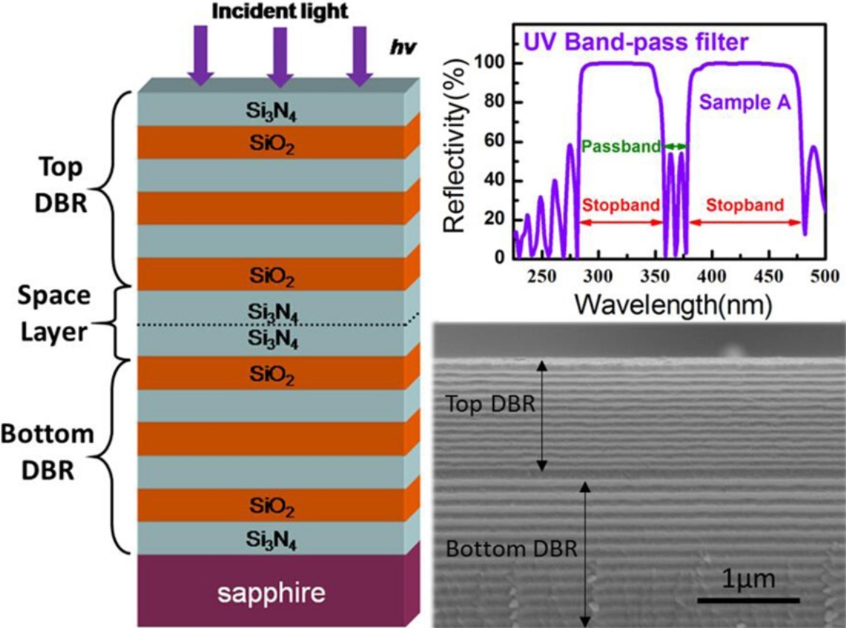
Distributed Bragg Reflector (DBR)

Slide 3
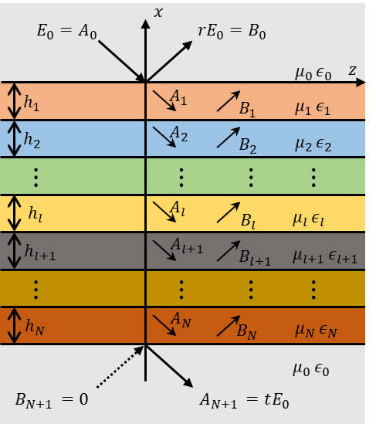



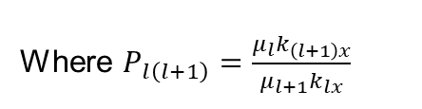
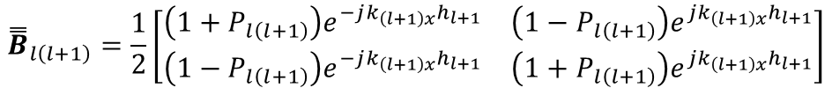

Transfer Matrix in Multilayered Medium
From boundary condition($E_{y}$ and $H_{z}$ are continuous)
$$\left[\begin{aligned}A_{l} \\ B_{l}\end{aligned}\right]={\overset{̿}{B}}_{l\left(l+1\right)}\left[\begin{aligned}A_{l+1} \\ B_{l+1} \end{aligned}\right]$$
Backward-propagation matrix
$${\overset{̿}{B}}_{l\left(l+1\right)}=\frac{1}{2}\left[\begin{matrix}\left(1+P_{l\left(l+1\right)}\right)e^{−jk_{\left(l+1\right)x}h_{l+1}} & \left(1−P_{l\left(l+1\right)}\right)e^{jk_{\left(l+1\right)x}h_{l+1}} \\ \left(1−P_{l\left(l+1\right)}\right)e^{−jk_{\left(l+1\right)x}h_{l+1}} & \left(1+P_{l\left(l+1\right)}\right)e^{jk_{\left(l+1\right)x}h_{l+1}}\end{matrix}\right]$$
Where $P_{l\left(l+1\right)}=\frac{μ_{l}k_{\left(l+1\right)x}}{μ_{l+1}k_{lx}}$
$$t=\frac{1}{b_{11}}, r=\frac{b_{21}}{b_{11}}$$
$$\left[\begin{aligned}E_{0} \\ rE_{0}\end{aligned}\right]= {\overset{̿}{B}}_{01}{\overset{̿}{B}}_{12}{\overset{̿}{B}}_{23}⋯{\overset{̿}{B}}_{N\left(N+1\right)}\left[\begin{aligned}A_{N+1} \\ B_{N+1}\end{aligned}\right]=\left[\begin{matrix}b_{11} & b_{12} \\ b_{21} & b_{22}\end{matrix}\right]\left[\begin{aligned}tE_{0} \\ 0\end{aligned}\right]$$

Slide 4
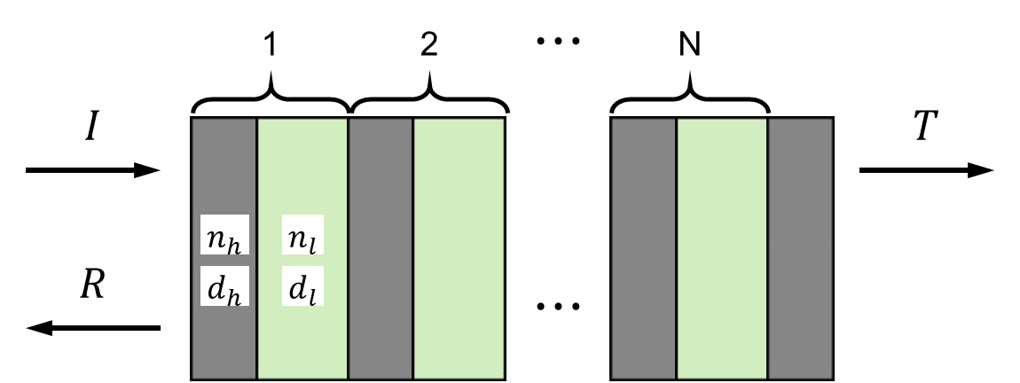


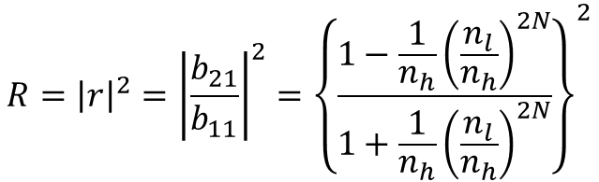
Distributed Bragg Reflector (DBR)
Multilayer structure of pairs of alternating materials with two different refractive index
For resonance, DBR has quarter wave optical thickness at certain design wavelength
$$n_{h}d_{h}=n_{l}d_{l}=λ_{0}/4$$
Transfer Matrix for N+1/2 pairs DBR
$${\overset{̿}{B}}_{DBR}=\left[\begin{matrix}b_{11} & b_{12} \\ b_{21} & b_{22}\end{matrix}\right]={\overset{̿}{B}}_{0h}{\left({\overset{̿}{B}}_{hl}{\overset{̿}{B}}_{lh}\right)}^{N}{\overset{̿}{B}}_{h0}$$
Reflectance at design wavelength
$$R={\left|r\right|}^{2}={\left|\frac{b_{21}}{b_{11}}\right|}^{2}={\left\{\frac{1−\frac{1}{n_{h}}{\left(\frac{n_{l}}{n_{h}}\right)}^{2N}}{1+\frac{1}{n_{h}}{\left(\frac{n_{l}}{n_{h}}\right)}^{2N}}\right\}}^{2}$$
Increasing N (# of pairs) & n_{l}/n_{h} (refractive index ratio), R converges to 1

Slide 5
Artificial Neural Network

Slide 6
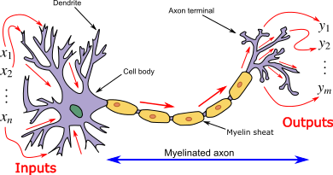
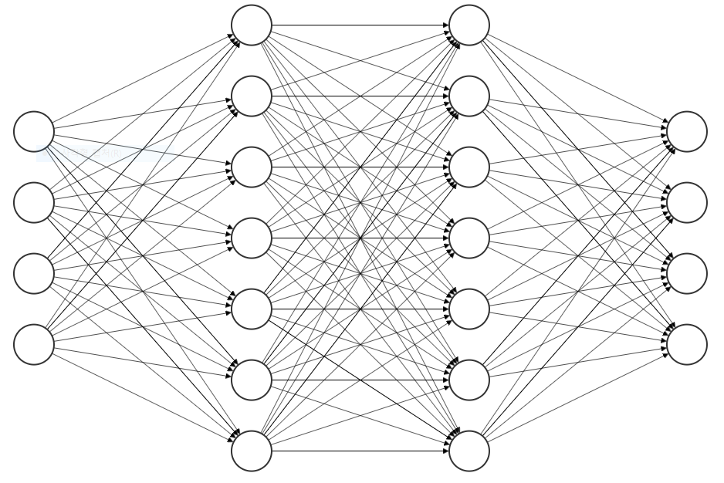
Artificial Neural Network (ANN)
Learning: adjust of nodes variable
layer
node
Input layer
Output layer
hidden layer

Slide 7
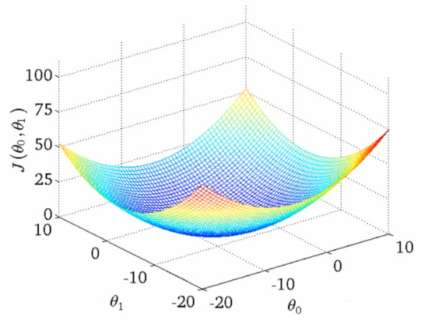

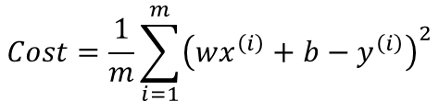


ANN Learning Process #1
bias
Training Data
b
Activation
function
x | y
1 | 2
2 | 3
3 | 4
x
1
2
3
weight
y
2
3
4
:
x
wx+b
y
w
$$Cost=\frac{1}{m}\sum_{i=1}^{m}{{\left(wx^{\left(i\right)}+b−y^{\left(i\right)}\right)}^{2}}$$
Minimize by
gradient descent algorithm
Gradient
$$Cost$$
$$W$$
$$b$$

Slide 8
ANN Learning Process #2
bias
Training Data
b
Activation
function
x | y
1 | 2
2 | 3
3 | 4
x
1
2
3
weight
y
2
3
4
:
x
wx+b
y
w
b = 1
w = 1
by Gradient descent method
bias
1
Activation
function
weight
x
4
x
1
wx+b
y
y
5

Slide 9
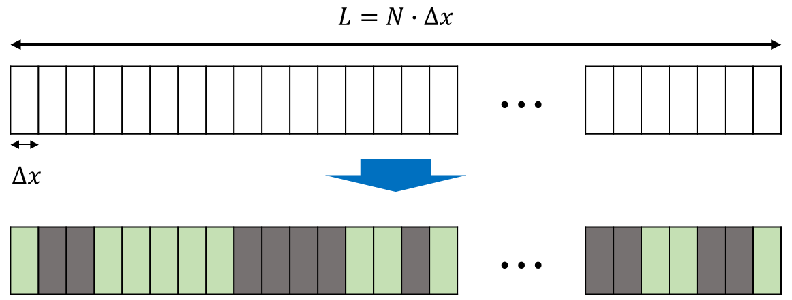
Inverse Design
Forward Design
R
Inverse Design

Slide 10
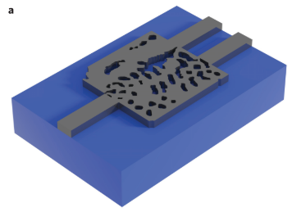




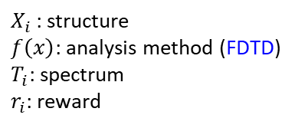



Normal Inverse Design
Cost
function
$X_{i}$
$$f\left(x\right)$$
$$T_{i}$$
$$r_{i}$$
$$\frac{1}{r_{i}}, Const.−r_{i}$$
$X_{i}$: structure
$f\left(x\right)$: analysis method (FDTD)
$T_{i}$: spectrum
$r_{i}$: reward
minimize
Gradient
$$Cost$$
$x_{i, jk}$
A. Y. Piggott et al., Nature Photonics, vol. 9, no. 6, pp. 374–377, Nov. 2015.
FDTD is too complex and heavy to calculate gradient

Slide 11
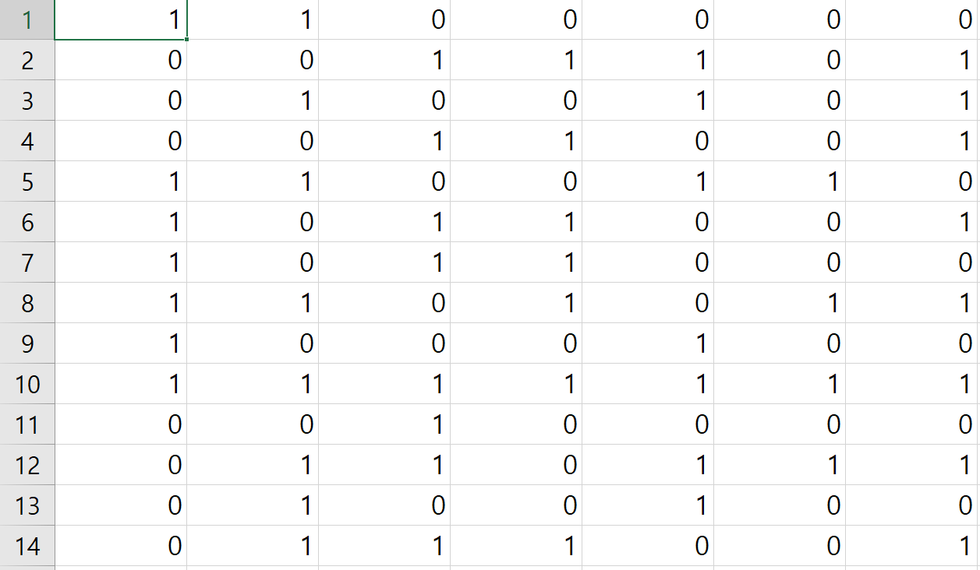
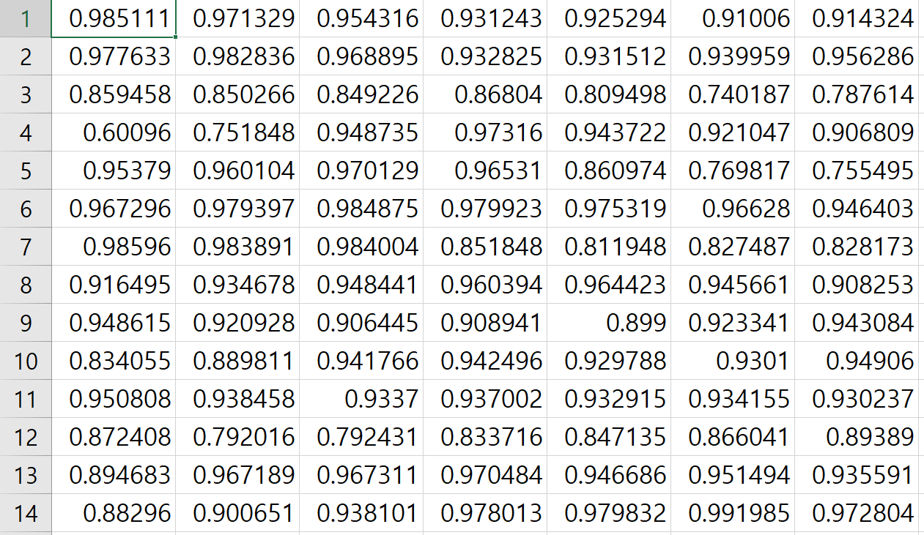

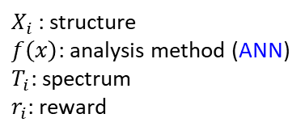



Inverse Design with ANN
FDTD → Artificial Neural Network
Learning
Neural
Network
$X_{i}$
$$f\left(x\right)$$
$$T_{i}$$
$$r_{i}$$
$X_{i}$: structure
$f\left(x\right)$: analysis method (ANN)
$T_{i}$: spectrum
$r_{i}$: reward
Artificial Neural Network
(ANN)
structures
spectrums

Slide 12
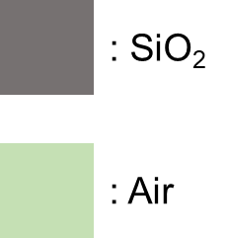
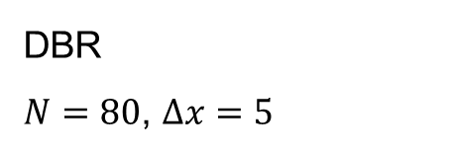
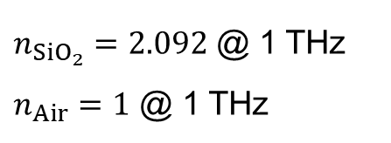
Design Platform - Structure
Start with index unknown material
$n_{{SiO}_{2}}=2.092$ @ 1 THz
$n_{Air}=1$ @ 1 THz
Design wavelength: 300 um (1 THz)
Wavelength: 150 – 3000 um (5 um step)
DBR
$N=80$, $∆x=5$

Slide 13
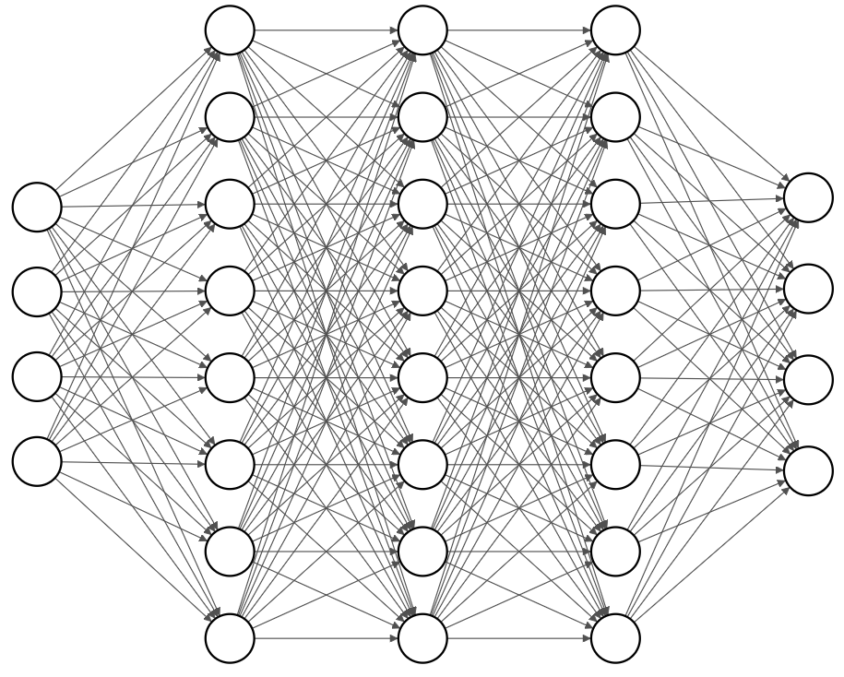
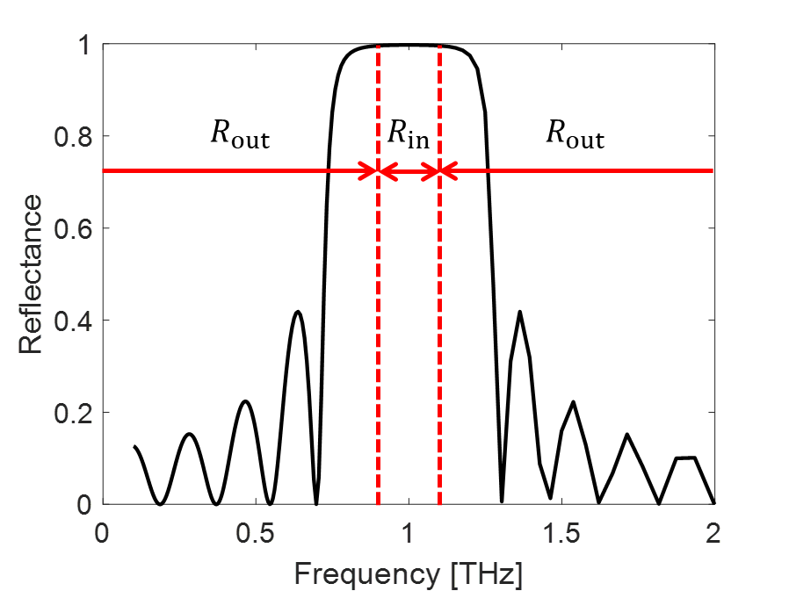
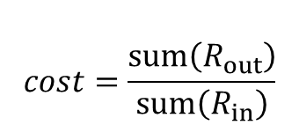
Design Platform - Algorithm
Input layer: 80 node
Output layer: 570 node
Hidden layer: 3 layer, 200 node
$$cost=\frac{sum\left(R_{out}\right)}{sum\left(R_{in}\right)}$$

